Slide 1



MOTOR FAULT DETECTION USING IOT

Slide 2
Presentation Overview
Introduction – Understanding the importance of motor fault detection.
Objectives – Key goals and expected outcomes of our project.
Problem Statement – Challenges in traditional motor fault detection methods.
Proposed Solution & Methodology – How our system works to overcome existing issues.
Hardware Components & Circuit Diagram – Explanation of the system’s architecture and connections.
Software Implementation – Programming logic, data processing, and IoT integration.
Real-Time Results – Analysis of the system’s performance and findings.
Challenges Faced – Difficulties encountered and how we addressed them.
Future Scope – Potential improvements and next steps for development.
Conclusion – Summary of key takeaways and project impact.

Slide 3
INTRODUCTION
Our project introduces an IoT-based real-time monitoring system that continuously tracks motor vibration levels to detect early signs of failure.
The system consists of a vibration sensor connected to an ESP8266 microcontroller, which continuously monitors vibration data to determine whether the motor is operating normally or experiencing faults.
If any abnormality is detected, the system alerts users via an LCD display and a mobile app (Blynk IoT platform), allowing for quick action to prevent damage.
Our project introduces an IoT-based system that continuously monitors motor vibrations using a sensor and ESP8266. It detects faults in real time and alerts users via an LCD display and Blynk IoT app, allowing quick action to prevent failures.

Slide 4
OBJECTIVES
Real-time fault detection:
Our system continuously monitors motor vibration levels and immediately identifies any unusual patterns.
By processing vibration data instantly, the system can detect faults before they lead to serious failures.
Reducing Maintenance Costs & Preventing Downtime
When faults are detected early, industries can take preventive action before a motor completely fails.
This helps avoid unexpected breakdowns, keeping operations running smoothly and minimizing repair costs.

Slide 5
Improving Industrial Efficiency & Equipment Lifespan:
With continuous monitoring, motors operate more efficiently, reducing wear and tear.
By using a cost-effective, IoT-enabled solution, industries can implement predictive maintenance, improving the lifespan of motors without relying on costly traditional monitoring methods.
Enabling Remote Monitoring & Smart Alerts:
The system integrates with the Blynk IoT platform, allowing users to monitor motor health from anywhere through a mobile app.
Instant alerts ensure that maintenance teams can take immediate action, reducing response time and improving overall system reliability.

Slide 6
Traditional Methods vs. Our System
Feature | Traditional Methods | Our IoT-Based System
Monitoring | Periodic, manual inspections | Continuous real-time monitoring
Fault Detection | Delayed, detected after failure | Early detection before failure
Alerts & Notifications | No automated alerts | Instant alerts via LCD & Blynk app
Cost & Efficiency | High maintenance cost | Cost-effective, reduces unnecessary checks
Remote Access | No remote monitoring | Can be accessed from anywhere using IoT
Scalability | Limited to single motors | Can be expanded with AI & additional sensors

Slide 7
PROBLEM STATEMENT
Unplanned motor failures: can cause significant downtime in industries, leading to financial losses and reduced productivity.
Traditional fault detection methods: rely on manual inspections, which are time-consuming, expensive, and often ineffective at identifying issues before they become serious.
Lack of real-time monitoring: means that faults are often detected too late, resulting in costly repairs and potential damage to other connected machinery.
Existing solutions: either require multiple sensors, making them complex and expensive, or they do not provide immediate alerts for preventive action.

Slide 8
PROPOSED Solution
Our system is designed to monitor motor health in real-time using a vibration sensor and an ESP8266 microcontroller.
The vibration sensor continuously collects data and sends it to the ESP8266 for processing.
If the detected vibrations exceed a predefined threshold, the system triggers an alert on an LCD screen and sends notifications through the Blynk IoT platform.
Additionally, the system can be expanded to integrate temperature and current sensors, allowing for a more comprehensive analysis of motor health

Slide 9
METHODOLOGY
Data Collection & Monitoring: The vibration sensor records motor vibrations and transmits the data to the ESP8266 microcontroller.
Fault Detection & Analysis: The ESP8266 processes the data using a predefined vibration analysis method to determine if a fault exists.
Alert Mechanism & Notifications: If a fault is detected, alerts are displayed on the LCD screen, and notifications are sent to users through the Blynk IoT app.
Scalability & Future Enhancements: The system is designed for easy integration of additional sensors, improving accuracy and expanding its applications.

Slide 10
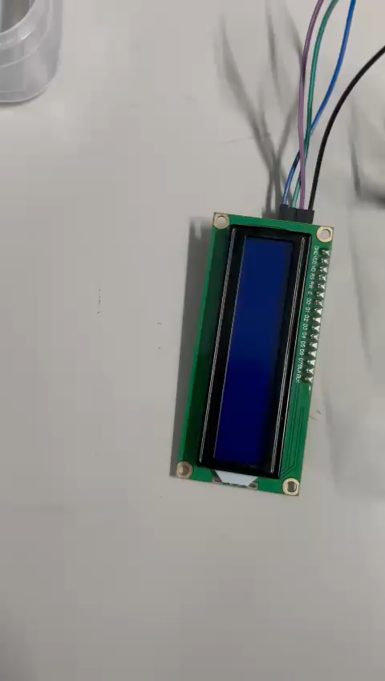
The Hardware Model working with basic code.

Slide 11
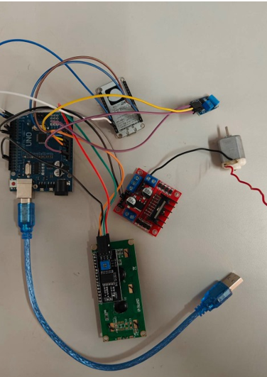
HARDWARE COMPONENTS USED
Arduino Uno – The brain of the system, processing vibration data.
Vibration Sensor – Detects unusual motor vibrations, indicating faults.
ESP8266 Wi-Fi Module – Enables remote monitoring by sending fault alerts.
16x2 LCD Display – Shows real-time motor health status.
Motor & Motor Driver –Controls the motor’s operation, regulating its speed and direction.
12V Adapter – Provides power to the components.
Jumper Wires – Connects all hardware components for proper functioning.

Slide 12
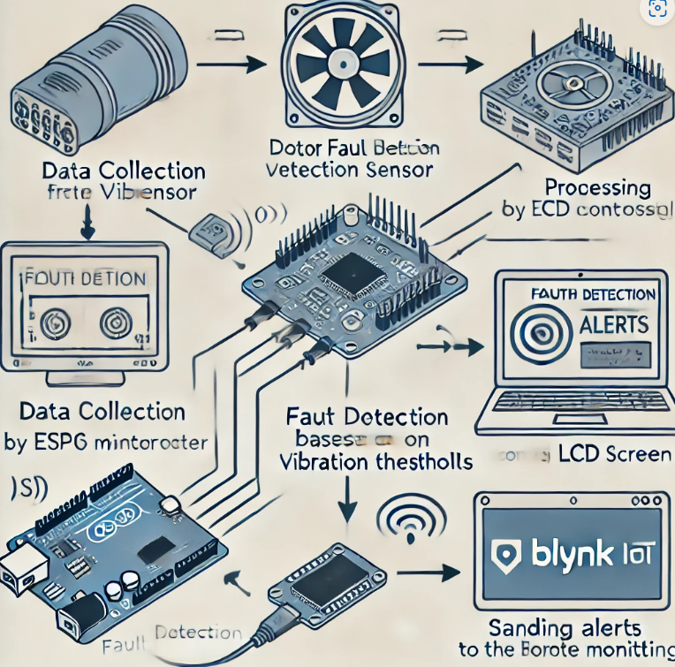
SOFTWARE IMPLEMENTATION
Arduino IDE: Used to program the ESP8266 for processing vibration data and detecting faults.
Blynk IoT Platform: Enables real-time monitoring and instant notifications for fault alerts.
LCD Display: Provides on-site status updates on motor vibrations and fault detection.
Wireless Data Transmission: ESP8266 sends processed data to the cloud for remote
access and analysis.
Optimized Fault Detection: Efficient code ensures quick response to
abnormal motor vibrations, reducing false alarms.

Slide 13
Real-Time Results & Demonstration
The hardware setup is successfully completed, and the LCD screen displays real-time vibration values from the motor.
The system detects abnormal vibrations and alerts the user when faults occur.
The next phase involves finalizing the IoT integration for remote monitoring through the Blynk IoT platform.
A demonstration will showcase how the hardware detects motor faults and displays alerts on the LCD.

Slide 14
CHALLENGES FACED AND THEIR SOLUTIONS
Challenges Faced:
Sensor Calibration Issues – Difficulty in setting accurate vibration thresholds, leading to incorrect fault detection.
Connectivity Problems – Inconsistent communication between ESP8266 and the Blynk IoT platform.
Solutions Implemented:
Optimized Sensor Calibration – Conducted repeated testing and fine-tuned vibration thresholds to improve accuracy.
Enhanced Connectivity – Adjusted Wi-Fi settings and optimized ESP8266 configurations for stable data transmission.

Slide 15
Future Scope
Additional Sensor Integration: Enhance fault detection accuracy by adding temperature and current sensors.
Scalability for Industries: Expand the system to monitor multiple motors simultaneously, making it adaptable for large-scale industries.
Automated Maintenance Scheduling: Use sensor data to automatically schedule preventive maintenance and reduce downtime.

Slide 16
CONCLUSION
Our IoT-based motor fault detection system successfully identifies faults in real time, reducing downtime and maintenance costs.
Remote monitoring via Blynk IoT ensures quick fault detection and response.
Future improvements like AI-based predictions and additional sensors will enhance efficiency.
This project demonstrates the importance of predictive maintenance in industrial applications.

Slide 17
User Interface Design
Motor Fault Detection App

Slide 18
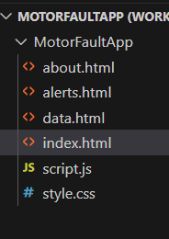
System Overview & Technologies
How it Works:
Vibration Sensor detects anomalies.
Arduino + ESP8266 process & send data.
App displays live data & alerts user.
Technologies Used:
Hardware: Arduino Uno, Vibration Sensor, ESP8266
Software: Android App (HTML, CSS, JavaScript)

Slide 19
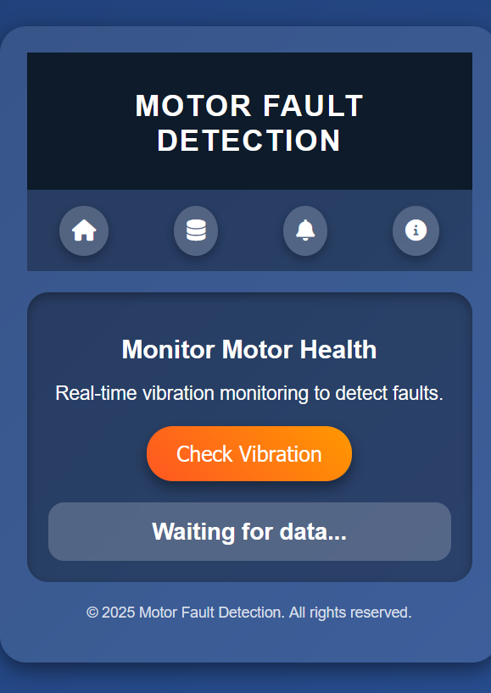
App Development Progress
UI designed & implemented.
Navigation & animations added.
Simulated sensor data working.
Next: Connect app with real hardware data.

Slide 20
Remaining Work & Future Scope
Connect App to Hardware (ESP8266 + Sensor)
Store past fault history in database
Implement real-time alert system
Future Scope:
AI-based fault prediction
Cloud integration for remote access

Slide 21
Conclusion
Our app provides smart motor monitoring.
Helps prevent unexpected failures & improve maintenance.
Future upgrades include AI & cloud integration.
In the app it will be containing fault alerts , about the app

